Slide 1
The Entity-Relationship Model
Conceptual Data Modeling
Lecture 3

Slide 2








Iconic Representations.......
Test your Memory
Can you Solve?
Objective
Coffee Break
Queries
Recap
Need more Info
Brainstorm

Slide 3
Objectives
The Entity-Relationship model
E-R Model Constructs : Entity, Entity Type , Entity Instance
Sample E-R Diagram
Entity type versus system input, output or user
Strong versus Weak entity type
Attributes in ER
Simple versus composite attributes
Single-Valued versus Multivalued Attribute
Relationship

Slide 4
Objectives. Contd.
Attributes on relationships
Degree of a relationship
Unary relationship
Binary relationships
Ternary relationships
Cardinality constraints

Slide 5
The Entity-Relationship model
The E-R model is a detailed, logical representation of the data for an organisation or business area.
It should be understandable to both the user and to the IT technologist.
The model must be as ‘open’ as possible and not tied to any technology or to any particular business methodology
It must be flexible enough so that it can be used and understood in practically any environment where information is modelled.
The E-R model is usually expressed as an E-R diagram

Slide 6
E-R Model Constructs
Entity - person, place, object, event, concept.
Entity Type - is a collection of entities that share common properties or characteristics.
Each entity type is given a name, since this name represents a set of items, it is always singular. It is placed inside the box representing the entity type.
Entity instance – is a single occurrence of an entity type. An entity type is described just once in a database, while many instances of that entity type may be represented by data stored in the database. e.g. – there is one EMPLOYEE entity type in most organizations, but there may be hundreds of instances of this entity stored in the database

Slide 7
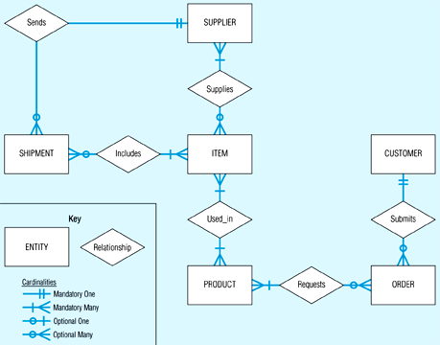
Sample E-R Diagram

Slide 8
Entity type versus system input, output or user
A common mistake is to confuse data entities with other elements of the ER model
A simple rule is that a true data entity will have many possible instances, each with a distinguishing characteristic.
  For. Eg.Treasurer is the person entering data – and data about the treasurer need not be kept

Slide 9
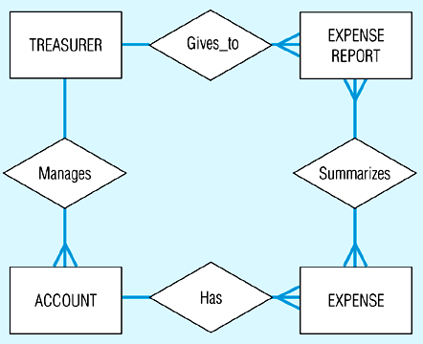
Example of inappropriate entities
(a) System user (Treasurer) and output (Expense Report) shown as entities

Slide 10
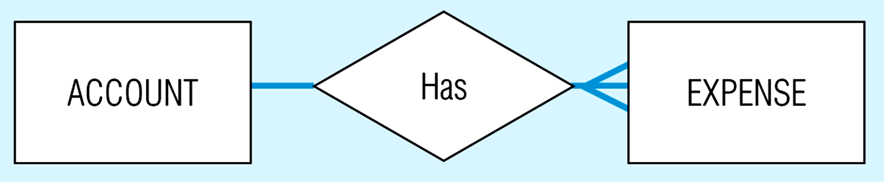
E-R model with only the necessary entities

Slide 11
Strong versus Weak entity type
  Most of the basic entity types are classified as strong entity types [Rectangle] – one that exists independently from other entity types (such as EMPLOYEE)
  Always have a unique characteristic (identifier) – an attribute or combination of attributes that uniquely distinguish each occurrence of that identity
  A weak entity type [[Double Rectangle]] – existence depends on some other entity type. It has no meaning in the ER diagram without the entity on which it depends (such as DEPENDENT)
  The entity type on which the weak entity type depends is called the Identifying owner (or owner for short).

Slide 12
Strong versus Weak entity type
  Identifying relationship is the relationship between a weak entity type and and its owner (such as ‘Has’ in the following Fig.)
  Weak entity identifier is its partial identifier (double underline) combined with that of its owner. During a later design stage dependent name will be combined with Employee_ID (the identifier of the owner) to form a full identifier for DEPENDENT.

Slide 13
Attributes
An attribute is a property or characteristic of an entity type, for example the entity EMPLOYEE may have attributes Employee_Name and Employee_Address.
In ER diagrams place attributes name in an ellipse with a line connecting it to its associated entity
Attributes may also be associated with relationships
An attribute is associated with exactly one entity or relationship

Slide 14
Simple versus composite attributes
Some attributes can be broken down into meaningful component parts, such as Address, which can be broken down into Street_Address, City..etc.
The component attributes may appear above or below the composite attribute on an ER diagram
Provide flexibility to users, as can refer to it as a single unit or to the individual components
A simple (atomic) attribute is one that cannot be broken down into smaller components

Slide 15
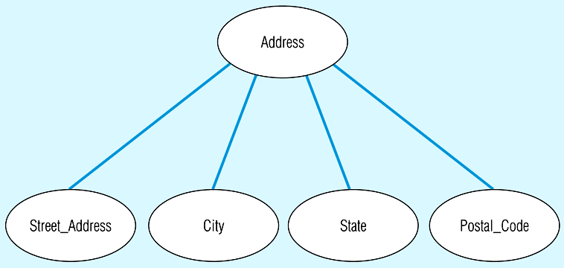
Eg: A composite attribute

Slide 16
Single-Valued versus Multivalued Attribute
It frequently happens that there is an attribute that may have more than one value for a given instance, e.g. EMPLOYEE may have more than one Skill.
A multivalued attribute is one that may take on more than one value – it is represented by an ellipse with double lines

Slide 17
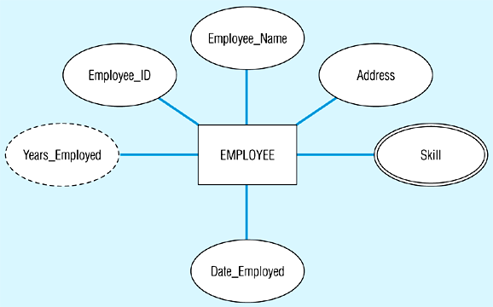
Entity with a multivalued attribute (Skill) and derived attribute (Years_Employed)

Slide 18
Stored versus Derived Attributes
Some attribute values can be calculated or derived from others
  e.g., if Years_Employed needs to be calculated for EMPLOYEE, it can be calculated using Date_Employed and Today's_Date
A derived attribute is one whose value can be calculated from related attribute values (plus possibly other data not in the database)
A derived attribute is signified by an ellipse with a dashed line (see previous Fig.)

Slide 19
Identifier attribute
Identifier attribute or Key is an attribute (or combination of attributes) that uniquely identifies individual instances of an entity type, such as Student_ID
To be a candidate identifier, each entity instance must have a single value for the attribute, and the attribute must be associated with each entity
The identifier attribute is underlined, such as Student_ID

Slide 20
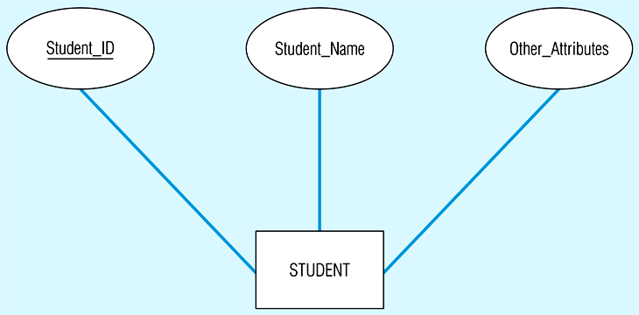
Simple and composite key attributes
Simple key attribute

Slide 21
Composite Identifier
A Composite Identifier is when there is no single (or atomic) that can serve as an identifier
Flight_ID is a composite identifier that has component attributes Flight_Number and Date – this combination is required to uniquely identify individual occurrences of Flight
Flight_ID is underlined, whilst its components are not

Slide 22
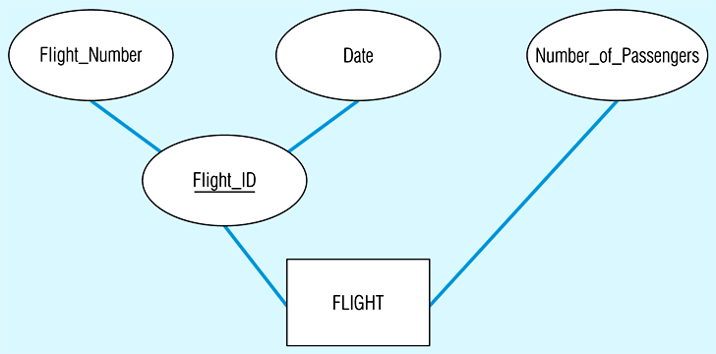
Composite key attribute

Slide 23
Criteria for selecting identifiers
Some entities have more than one candidate identifier, so the following criteria should be used:
  Choose identifier that will not change in value over the life of each instance of the entity type.
  Choose identifier that is guaranteed to have valid values and Will not be null (or unknown). If composite, make sure all parts will have valid values.
  Avoid the use of intelligent identifiers whose structure indicates classifications, locations or people that might change. e.g. the first two digits of an identifier may indicate a warehouse location, but such codes are often changed as conditions change, which renders them invalid.

Slide 24
Relationships
A relationship is an association among the instances of one or more entity types that is of interest to the organization
Relationship Type is a meaningful association between (or among) entities – implying that the relationship allows us to answer questions that could not be answered given only the entity types. It is denoted by a diamond symbol

Slide 25
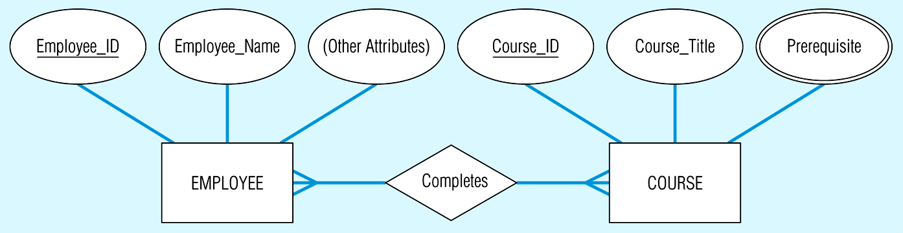
Relationship types and instances
(a) Relationship type (Completes)

Slide 26
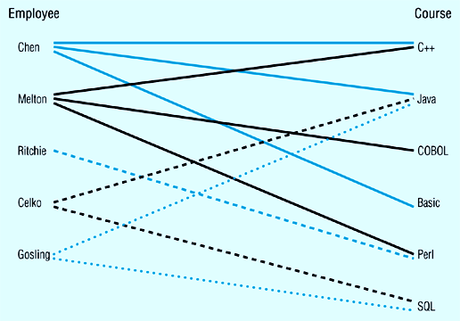
Relationship instance
Is an association between (or among) entity instances, where each relationship includes exactly one entity from each participating entity type.
  For example, Each line represents a relationship instance between one employee and one course, indicating that the employee has completed that course.

Slide 27
(b) Relationship instances

Slide 28
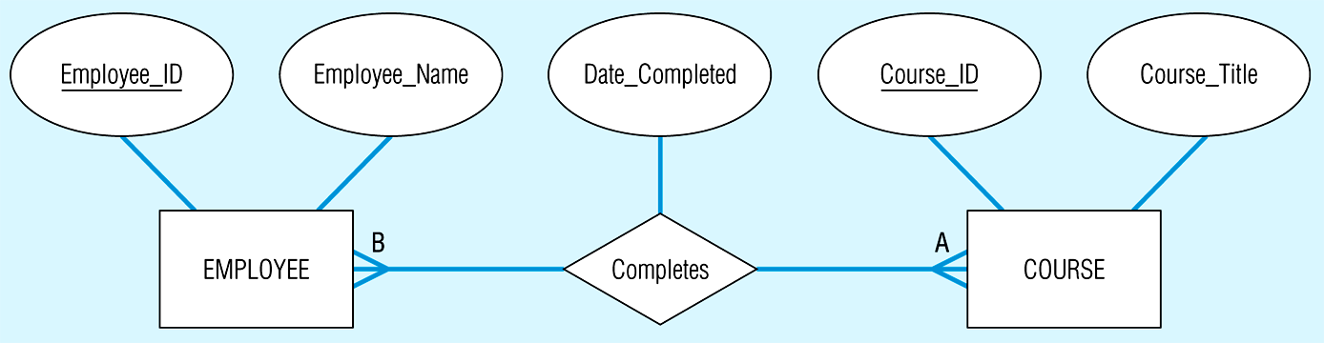
Attributes on relationships
Attributes may be associated with a many-to-many (or one-to-one) relationship, as well as with an entity
  e.g., an organisation may want to record the date when an employee completes each course
In the following diagram, the relationship ‘Completes’ joins the EMPLOYEE and COURSE entities, and Date_Completed is joined to this as it is a property of the relationship ‘Completes’

Slide 29
Associative entities
The presence of one or more attributes on a relationship suggests that the relationship should perhaps be represented as an entity type
An associative entity is an entity type that associates the instances of one or more entity types and contains attributes that are peculiar to the relationship between those entity instances.
The associative entity type CERTIFICATE is represented with the diamond relationship symbol enclosed within the entity rectangle

Slide 30
Associative entities . . . . Contd.
The associative entity has one or more attributes in addition to the identifier
The associative entity participates in one or more relationships independent of the entities related in the associated relationship
The following figure shows the relationship ‘Completes’ converted to an associative entity type
A CERTIFICATE is awarded to each EMPLOYEE who completes a COURSE, each certificate has a Certificate_Number that serves as the identifier

Slide 31
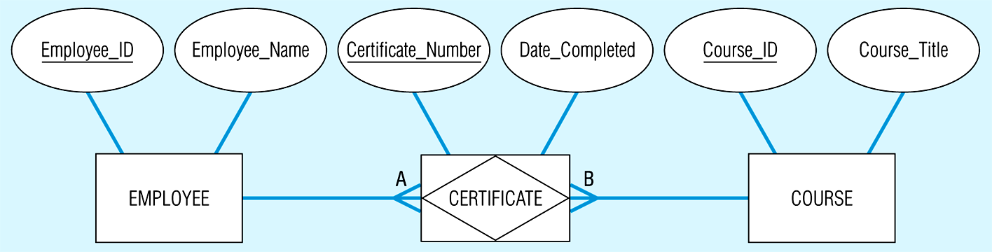
Associative entities . . . . Contd.
(b) An associative entity (CERTIFICATE)

Slide 32
Degree of a relationship
Is the number of entity types that participate in it.
Thus ‘Completes’ has degree 2, since there are two participating entity types, EMPLOYEE and COURSE
The three most common relationship degrees are unary (degree 1), binary (degree 2) and ternary
Higher degree relationships are possible but rarely encountered in practice

Slide 33
Unary relationship
Is between the instances of a single entity type (also called recursive relationships)
‘Is_Married_To’ is a one-to-one relationship between instances of the PERSON entity type
‘Manages’ is a one-to-many relationship between instances of the EMPLOYEE entity type

Slide 34
Binary relationships
Between the instances of two entity types, and is the most common type of relationship encountered in data modelling. e.g. (one-to-one) an EMPLOYEE is assigned one PARKING_PLACE, and each PARKING_PLACE is assigned to one EMPLOYEE
e.g. (one to many) a PRODUCT_LINE may contain many PRODUCTS, and each PRODUCT belongs to only one PRODUCT_LINE
e.g. (many-to-many) a STUDENT may register for more than one COURSE, and each COURSE may have many STUDENTS

Slide 35
Ternary relationships
A ternary relationship is a simultaneous relationship among the instances of 3 entity types
It is the most common relationship encountered in data modelling
The following Fig. shows a typical ternary relationship
Here, vendors can supply various parts to warehouses

Slide 36
Ternary relationships contd....
The relationship ‘Supplies’ is used to record the specific PARTs supplied by a given VENDOR to a particular WAREHOUSE
There are two attributes on the relationship ‘Supplies’, Shipping_Mode and Unit_Cost
e.g. one instance of ‘Supplies might record that VENDOR X can ship PART C to WAREHOUSE Y, that the Shipping_Mode is ‘next_day_air’ and the Unit_Cost is £5-00 per unit

Slide 37
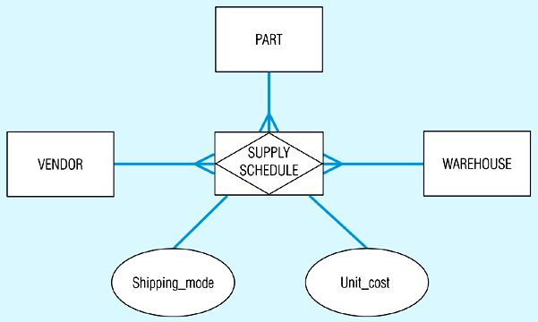
Ternary relationships

Slide 38
Ternary relationships
We do not use diamond symbols on the lines from SUPPLY_SCHEDULE to the three entities, because these lines do not represent binary relationships
It is recommended that all ternary (or higher) relationships are converted into associative entities (as in the Fig.), as it makes the representation of participation constraints (discussed later) easier
Many CASE tools cannot represent ternary relationships, so you must represent the ternary relationship with an associative entity and three binary relationships

Slide 39
Cardinality constraints
The number of instances of one entity that can or must be associated with each instance of another entity.
If we have two entity types A and B, the cardinality constraint specifies the number of instances of entity B that can (or must) be associated with entity A
  e.g. a video store may stock more than one VIDEOTAPE for each MOVIE, this is a ‘one-to-many’ relationship as in the following Fig.

Slide 40
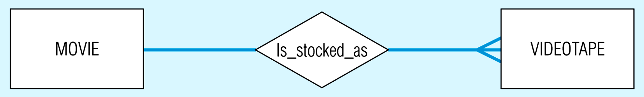
Introducing cardinality constraints
(a) Basic relationship

Slide 41
Minimum cardinality
The minimum cardinality of a relationship is the minimum number of instances of an entity B that may be associated with each instance of an entity A
In our example, the minimum number of VIDEOTAPES of a MOVIE is zero (entity B is an optional participant in the ‘Is_Stocked_As’ relationship)
This is signified by the symbol zero through the arrow near the VIDEOTAPE entity in the following Fig.

Slide 42
Maximum cardinality
Is the maximum number of instances of an entity B that may be associated with each instance of entity A
In the following Fig., the maximum cardinality for the VIDEOTAPE entity type is ‘many’ (an unspecified number greater than 1)
This is indicated by the ‘crow’s foot’ symbol on the arrow next to the VIDEOTAPE entity symbol

Slide 43
Mandatory one cardinality
Relationships are bi-directional, so there is also cardinality notation next to the MOVIE entity.
Notice that as the minimum and maximum are both one, this is called mandatory one cardinality (i.e., each VIDEOTAPE of a MOVIE must be a copy of exactly one movie)
In the following Fig. Some attributes have been added. VIDEOTAPE is represented as a weak entity because it cannot exist unless the original owner movie also exists.
The identifier of the MOVIE is ‘Movie_Name’

Slide 44
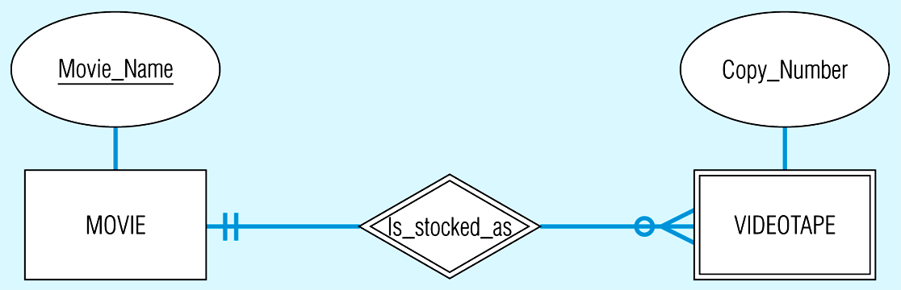
Relationship with cardinality constraints

Slide 45
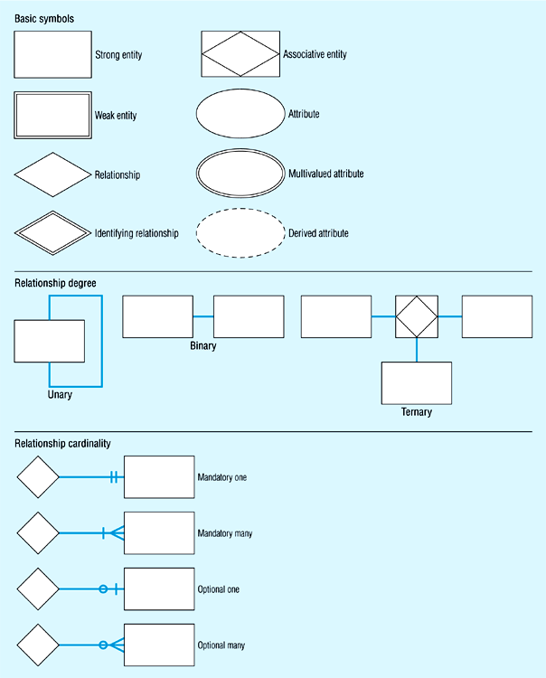
Review of Basic E-R Notation

Slide 46
Brainstorm

Slide 47
Queries

Slide 48
Recap
The E-R model is a detailed, logical representation of the data for an organisation or business area
The E-R model is usually expressed as an E-R diagram

Slide 49
Quiz…
The entity type on which the weak entity type depends is called the Identifying owner
  True
  False
In ER diagrams place attributes name in an rectange with a line connecting it to its associated entity
  True
  False
A simple (atomic) attribute is one that can be broken down into smaller components
  True
  False

